Slide 1
uLCD Driver for Raspberry PI
ECE 4180 Final Project
Yue Teng, Huang Yao
12/15/2021

Slide 2
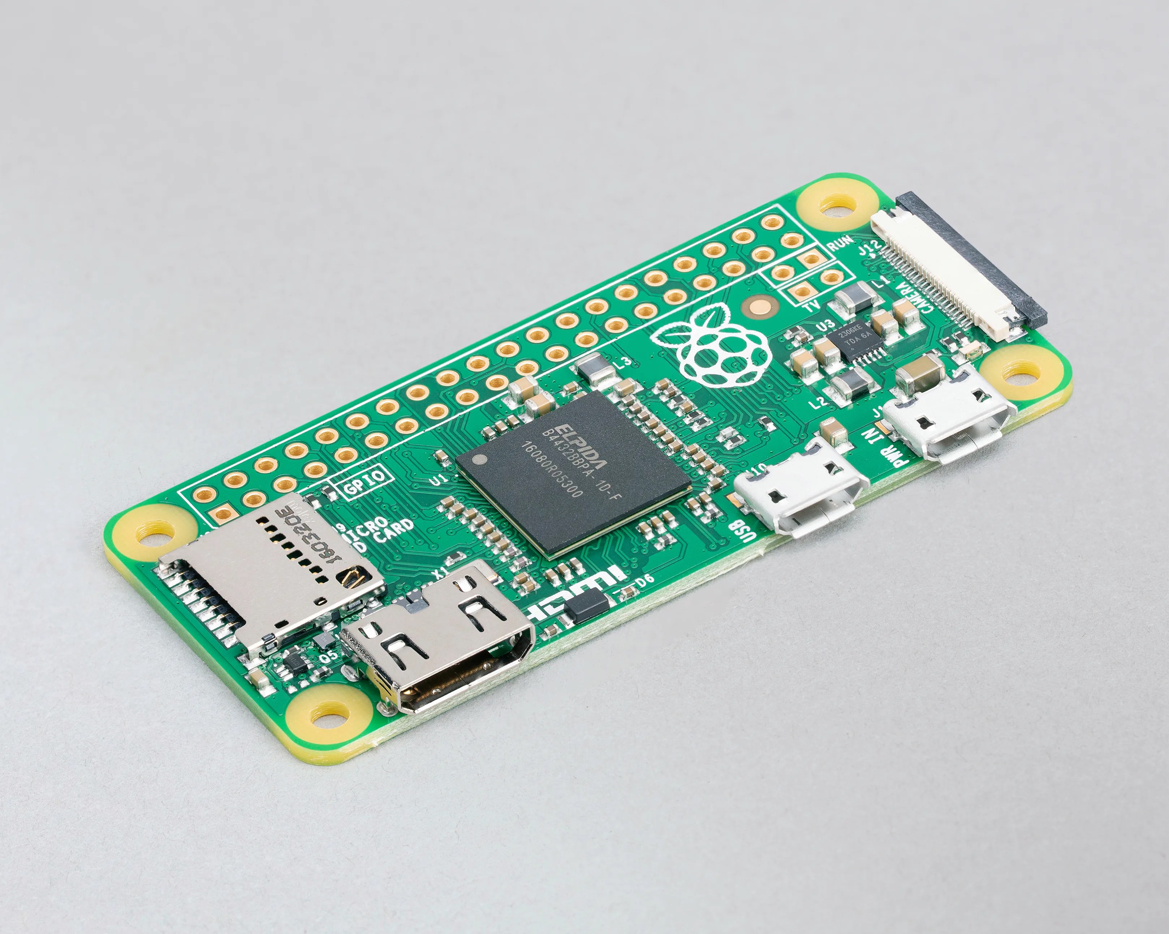
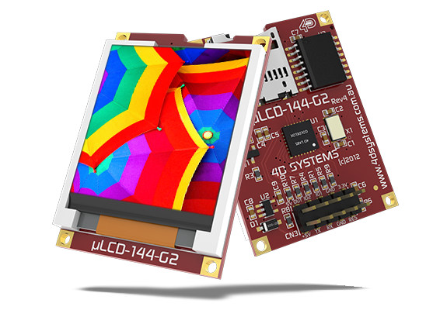
Project Idea
Since Raspberry PI is a popular embedded system, we want to explore more of its functions
We know that mbed can interact with other hardware such as uLCD through its serial port. We therefore came up with the idea to write a uLCD driver for PI through its serial (UART) port
SERIAL

Slide 3
Implementation
Modified uLCD_4DGL library
Serial
Mini UART: TXD and RXD on raspberry pi
New static & instance variables
static int _fd; // port number
int _rst; // GPIO pin number
char _read_buf;
read() in non-blocking mode
Change baud rate with termios.h
lcd_rintf()
Did not find any Stream Class equivalent
Wrote a lcd_printf() wrapper which calls vsnprintf() and puts()
Static error handler and exit handler
Terminate GPIO, close serial port, kill parent & current processes

Slide 4
Demo
Change baud rate to 115200
Helloworld
Graphics
Image
https://youtu.be/25nRmoWS9jM

Slide 5
Summary
We see that the data has been successfully transmitted from PI to uLCD through serial
Our project is successful, and we have learned more about Raspberry PI and the serial data bus
Future work: possibly write a more efficient printf()

